Slide 1


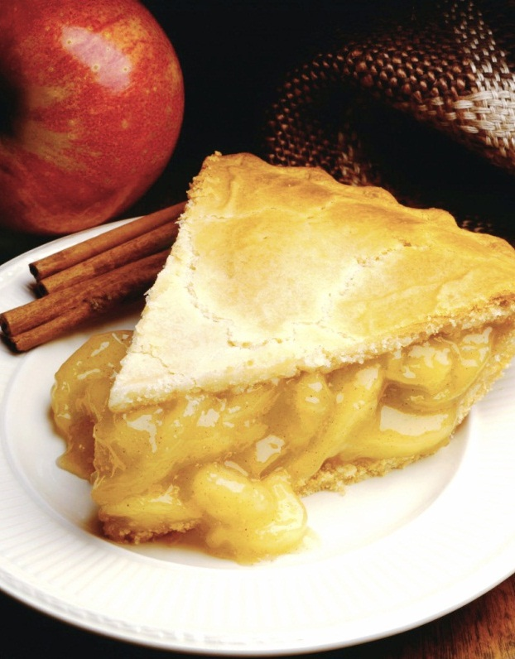
ONLINE FAST FOOD ORDERING
Notes:
NOTE: To replace a picture, just select and delete it. Then use the Insert Picture icon to replace it with one of your own!

Slide 2

Features ONLINE FOOD ORDERING SYSTEM
Accept orders from All Directions-Mobile Phone, QR Scan.
Customers can find restaurants near to him using Google Map.
Helps to customers to order their food directly in home.
Hotel owners can provide more offers through this web.
It also can provide the food in your affordable price , customers can enter their amount and get food references.
Ready to use Online Payment Options Cash/credit Cards.
One more feature of our web is , people can upload recipes with photo .

Slide 3
CONTACTLESS ORDERING
4 Main Aspect Of Contactless Ordering
Contactless Menu
Contactless Ordering
Contactless Payment
Contactless Receipts

Slide 4
CONTACTLESS MENU
How to Contactless view food menu?
Customer to scan Online Food Menu by QR Code.

Slide 5
CONTACTLESS ORDERING
How to Contactless Ordering?
Customer choose their favorite food, then proceed to place order on their phone.

Slide 6
CONTACTLESS PAYMENT
How to Contactless Payment?
Customer proceed to select their preferred payment method.
Customer can choose to pay by credit card, online bank transfer.

Slide 7
CONTACTLESS RECEIPT
How to Contactless Receipt?
Once order is confirmed , customer will receive a copy of receipt by email.

Slide 8
WHY CONTACTLESS ORDERING?
Advantages of Contactless Ordering by using Contactless/QR Code Ordering.
Self Service –Less Waiting Time
Zero Order Mistake by Waiter
Save Cost on Printing Food Menu
Fully Automated Ordering System

Slide 9
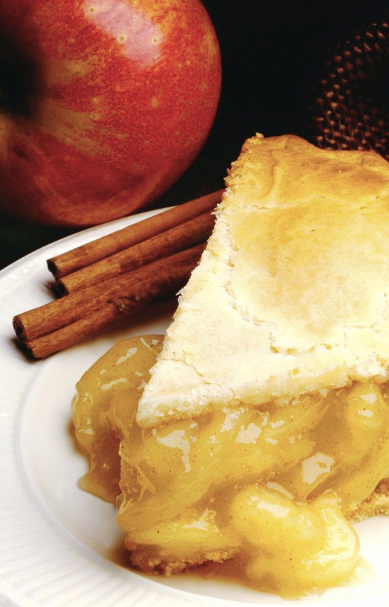
THANK
YOU..!

